Slide 1

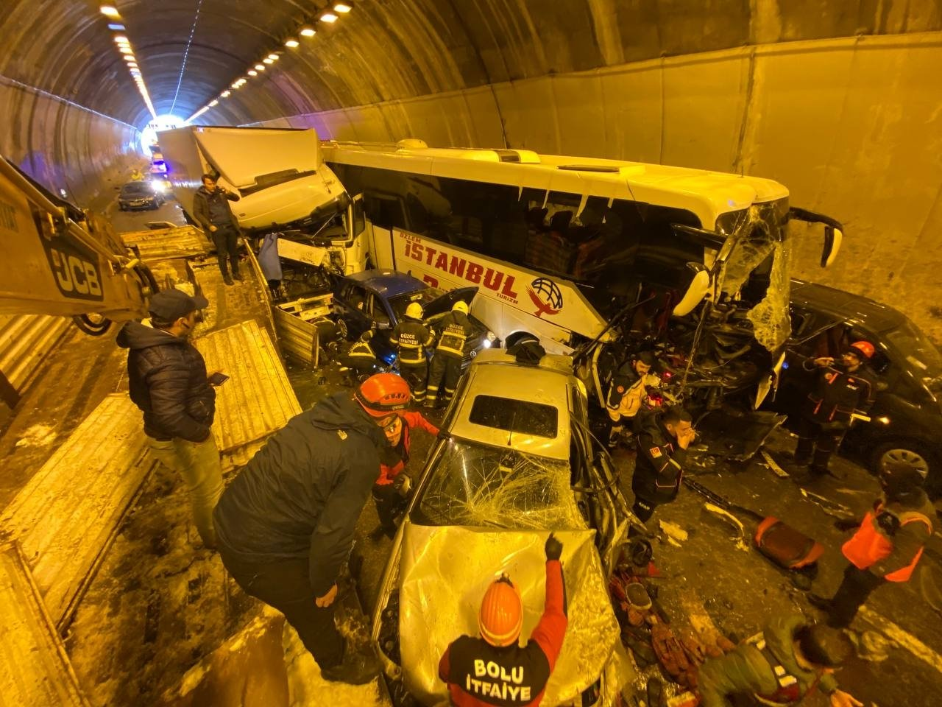
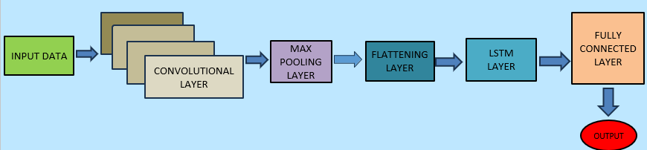
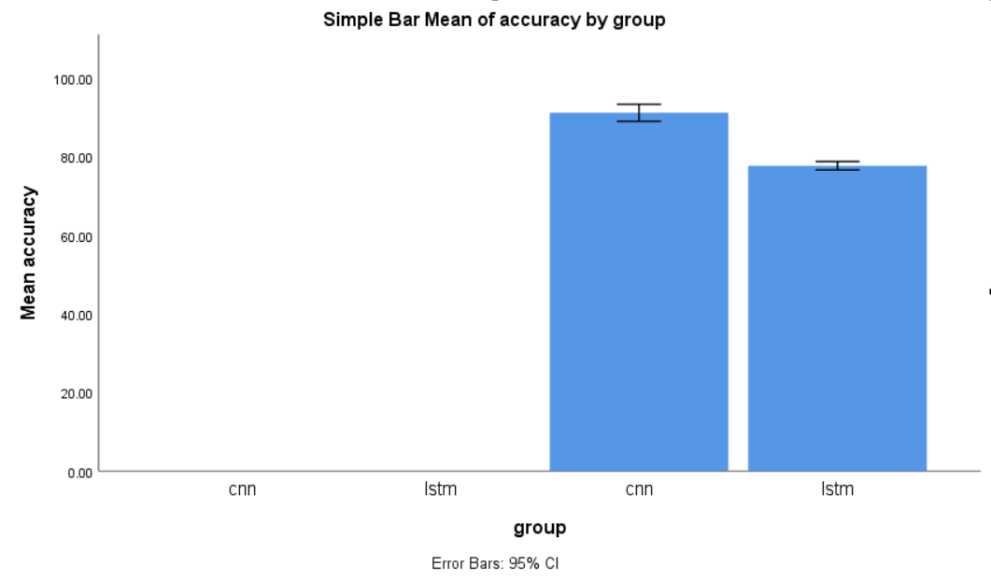
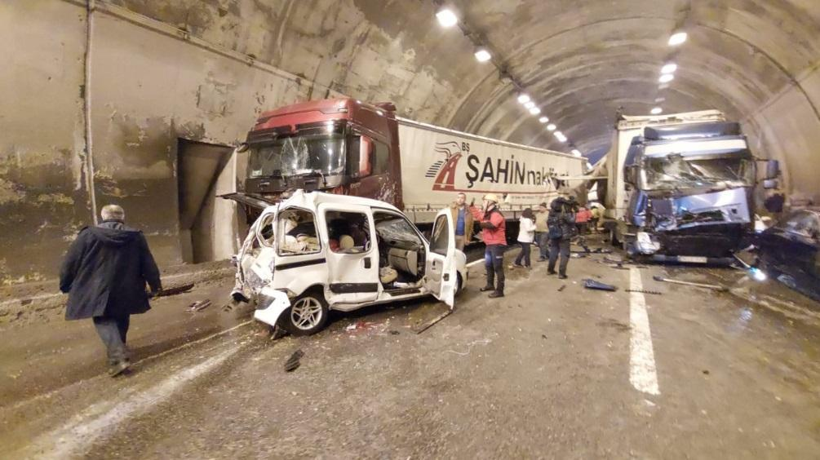
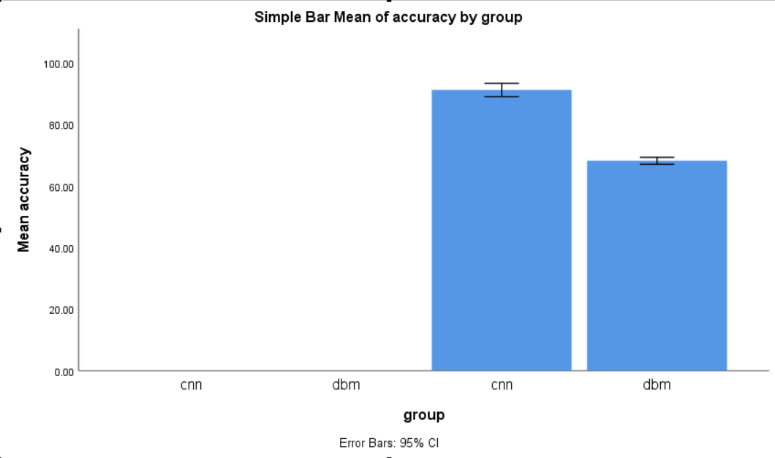
Register No: 192372321
Students Name: D V Sai kumar
Guided By: Dr.P.Suresh
Automating the detection of unexpected accidents in tunnels using Convolutional Neural Networks (CNN) in comparison with Long Short-Term Memory (LSTM) networks.
INTRODUCTION
Accidents in tunnels pose significant safety risks due to limited accessibility and delayed responses.
Conventional detection systems may lack real-time monitoring capabilities, prompting the need for
advanced techniques.
Convolutional Neural Networks (CNNs) are effective in analyzing visual data, making them suitable
accident detection footage.
The research compares CNNs and LSTMs to determine which model offers superior performance
in accident detection
MATERIALS AND METHODS
Fig:1 Accident detection in tunnels
1
2
3
RESULTS
CNN achieved an accuracy of 93.4%, outperforming LSTM’s 91.2%.
2. Precision was higher in CNN (92.0%) compared to LSTM (90.0%).
3. CNN also had better recall at 94.5%, while LSTM had 92.5%.
4. F1-score for CNN was 93.2%, slightly above LSTM’s 91.2%.
Comparing CNN and LSTM
DISCUSSION AND CONCLUSION
Based on T-test Statistical analysis, the significance value of p=0.001 (independent sample T - test p<0.05) is obtained and shows that is a stastical
significant difference between the group 1 , group 2.
2. Overall , the accuracy of the tensile strength is 68.95% and it is better than the line infill pattern.
Control group mean difference tensile strength of =56.4(MPa)
Experimental group mean difference tensile strength of =62.2(MPa)
Obtained p-value =0.009
3. The T-test Statistical analysis resulted in a significant p-value of 0.001 (independent sample T-test p<0.05), indicating a statistically significant difference between group 1 and group 2.
BIBLIOGRAPHY
LeCun, Y., Bengio, Y., & Hinton, G. (2015). Deep learning. Nature, 521(7553), 436-444.
Cheng, Y., & Xie, L. (2019). Deep learning-based automatic traffic accident detection in intelligent transportation systems. IEEE Access, 7, 60717-60726.
Agarwal, P., & Agarwal, A. (2018). LSTM based traffic accident detection and prediction system. International Journal of Engineering & Technology, 7(4), 2372-2380.
Automated detection of unexpected accidents in tunnels by using CNN in comparison with DBM
INTRODUCTION
1. Timely detection of accidents in tunnels is crucial for safety due to limited visibility and space constraints.
2. Deep Belief Networks (DBMs) are effective in detecting accidents by learning the normal state of the tunnel
and identifying deviations, especially with limited labeled data.
3. Combining CNNs for real-time visual detection and DBMs for anomaly detection can offer a more robust
solution for tunnel safety.
4. CNNs are faster and more accurate in real-time detection, while DBMs handle unlabeled data and
environmental variations better but are slower. Fig :1 Accident detection in tunnels
MATERIALS AND METHODS
Pre-processing
Video to frames
Feature Representation
Classification Using Deep RNN
Performance evalution (output)
Input:
Traffic accident video
Data collection
Fast, Global features extraction , Deep CNN
HSV, Hue , Saturation images, Element response, training performance, error and correlation computation
RESULTS
1. CNN achieved a higher accuracy of 94.1% compared to DBM’s 89.5%.
2. Precision for CNN was 93.0%, outperforming DBM's 88.2%.
3. CNN recorded a recall of 95.0%, while DBM had 90.7%.
4. F1-score was better in CNN (94.0%) than DBM (89.4%), indicating superior overall performance
Comparing CNN and DBM
DISCUSSION AND CONCLUSION
Based on T-test Statistical analysis, the significance value of p=0.001 (independent sample T - test p<0.05) is obtained and shows that is a stastical significant difference between the group 1 and group 2.
2. Overall , the accuracy of the tensile strength is 68.95% and it is better than the line infill pattern.
Control group mean difference tensile strength of =56.4(MPa)
Experimental group mean difference tensile strength of =62.2(MPa)
Obtained p-value =0.009
BIBLIOGRAPHY
LeCun, Y., Bengio, Y., & Hinton, G. (2015). Deep learning. Nature, 521(7553), 436-444.
Overview of deep learning techniques, including CNNs, and their applications in image recognition.
[DOI: 10.1038/nature14539]
Hinton, G. E., Osindero, S., & Teh, Y. W. (2006). A fast learning algorithm for deep belief nets. Neural Computation, 18(7), 1527-1554
Zhao, R., & Wang, X. (2017). Deep belief networks for anomaly detection in surveillance systems. Proceedings of the 2017 International Conference on Machine Learning and Data Mining (MLDM), 567-576.
.

